Slide 1
Web
Development
Olli Lohikoski L21d

Slide 2

What is web development?
Creating, building and maintaining websites.
Includes many aspects such as web design, web publishing and web programming

Slide 3
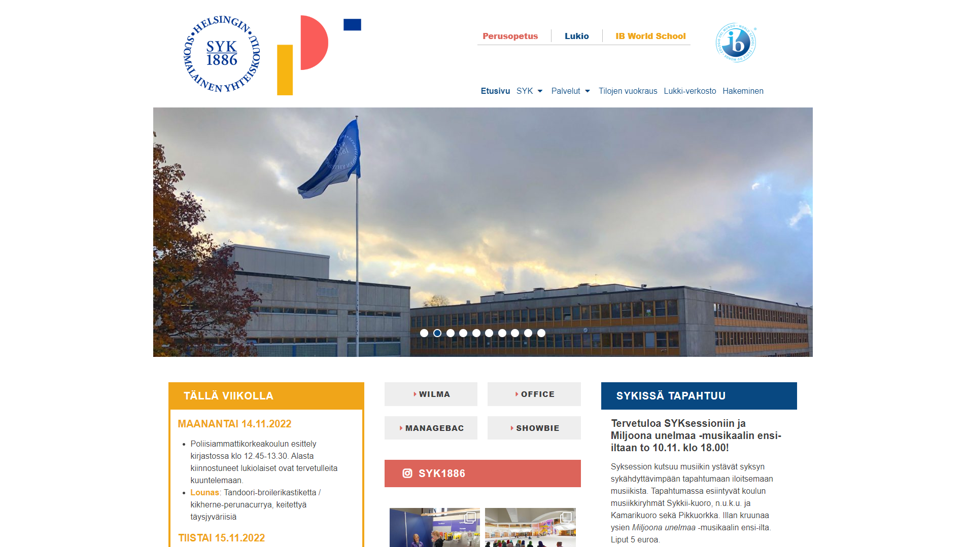

Slide 4
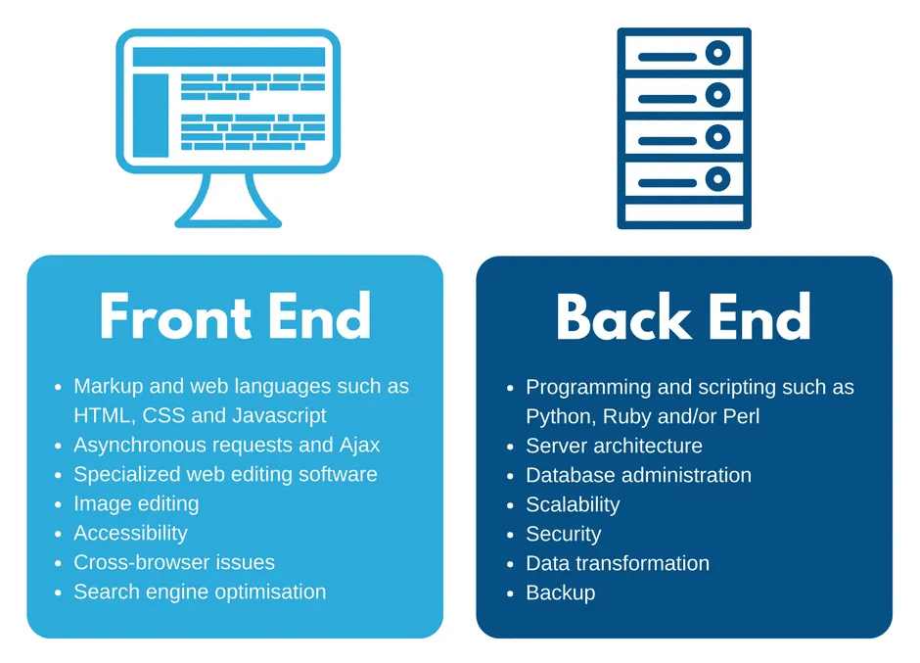

Slide 5
What tools and technologies?

Slide 6
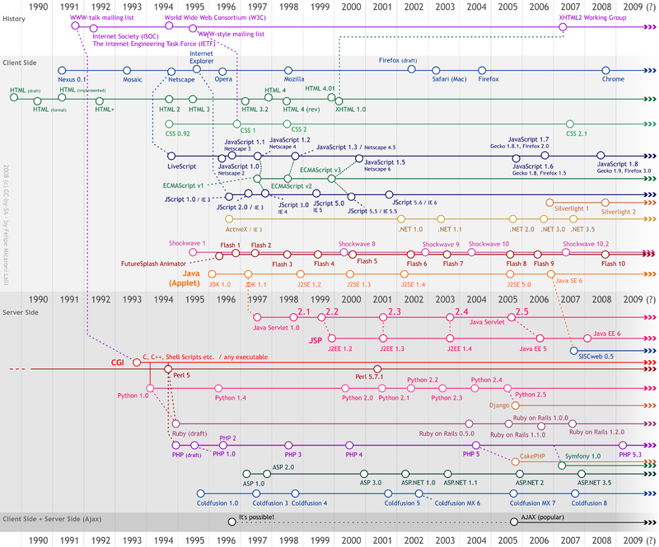

Slide 7
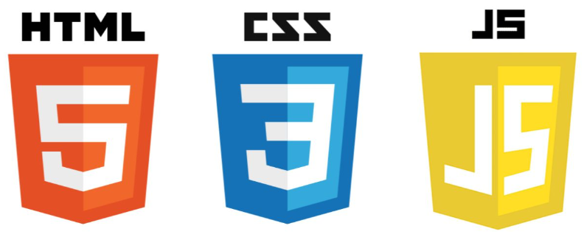
What we’ll use today:
Hypertext markdown language
Cascading Style Sheets
Ja
JavaScript
Java

Slide 8
Let’s get to coding.

Slide 9
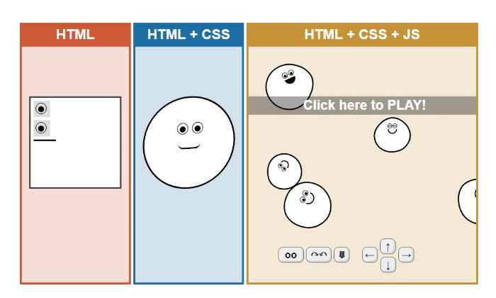

Slide 10

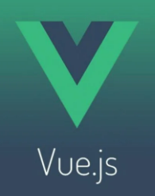






Other frontend technologies

